Slide 1

Cyber Guardians:
[AI + Blockchain for Women’s Safety]
Quantum Protectors | CIEL Kingston VibeAIthon 2025

Slide 2


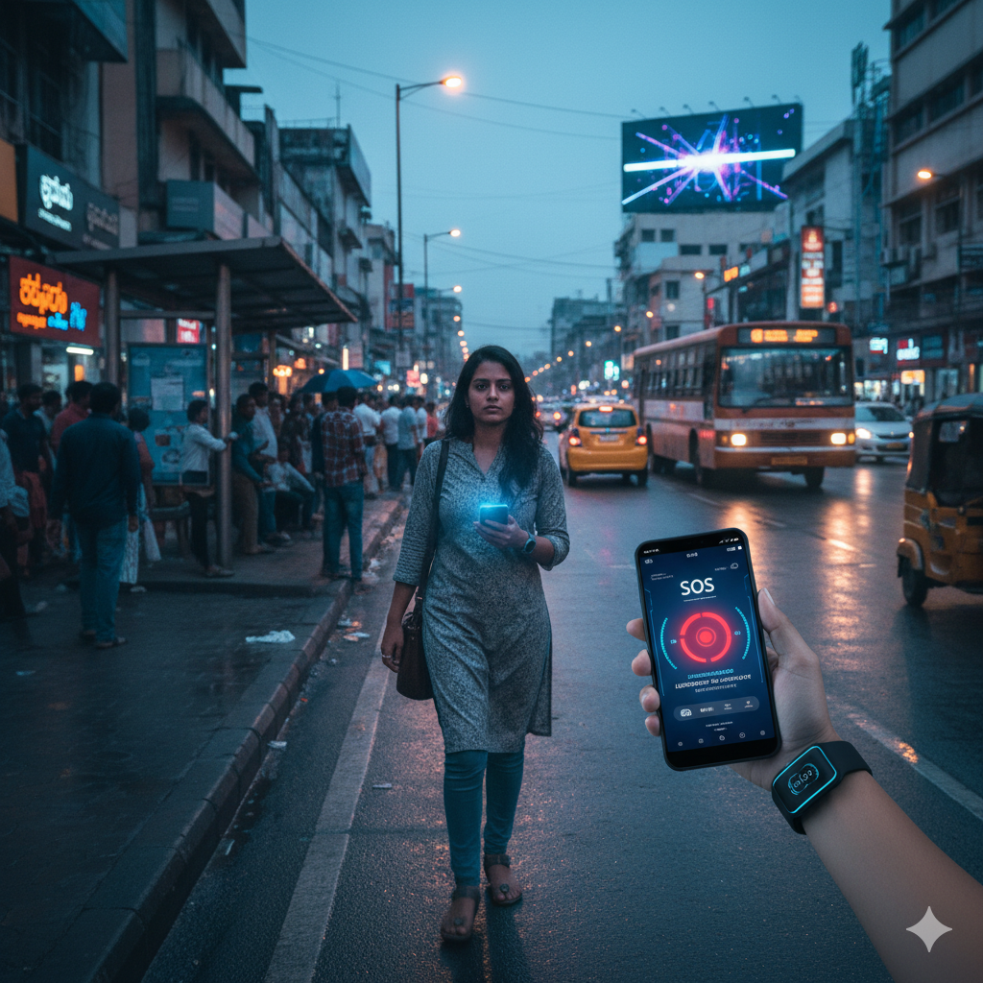
Problem Recap & Objective
Problem:
Women face increasing danger in public spaces; existing safety apps can be delayed, tampered with, or send false alerts.
Objective:
Develop a cyber-secured wearable + AI-powered app that detects distress automatically and sends tamper-proof, encrypted SOS alerts in real time.
Expected Outcomes:
Instant danger detection
Immutable blockchain alert record
Faster, verified emergency response

Slide 3
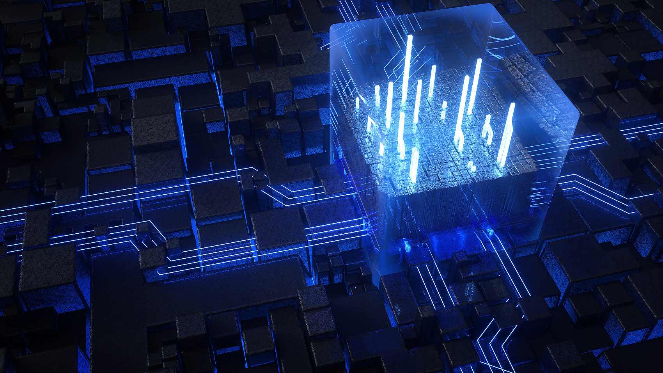
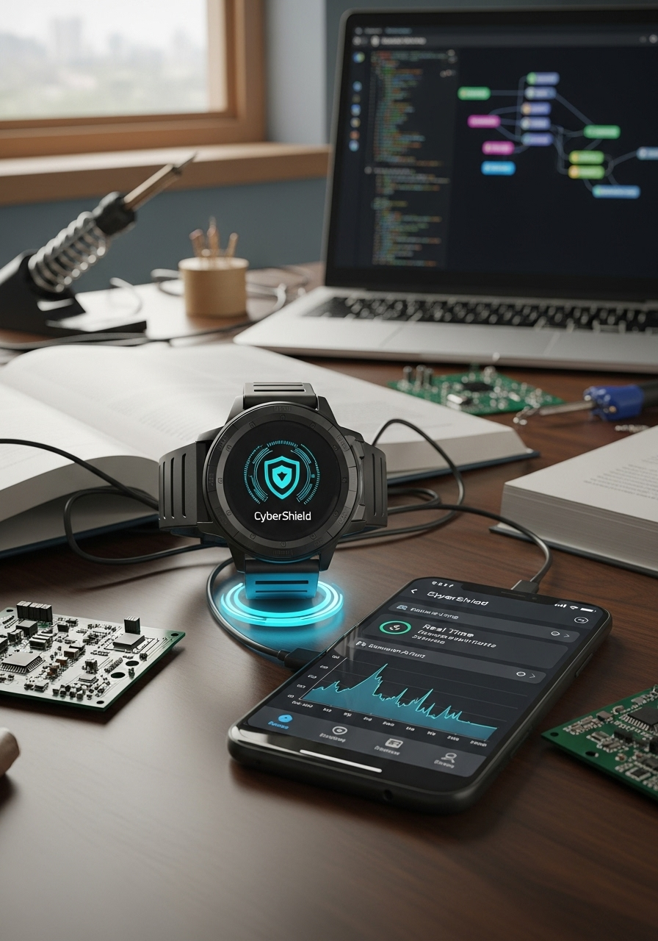
Prototype Overview
Prototype Type: Functional Simulation (App + Wearable Concept)
How It Works:
Wearable detects panic → AI verifies threat → Encrypted blockchain alert → Notifies verified responders → Safety confirmed.
Technology Stack:
AI/ML: Voice & motion anomaly detection
Blockchain: Immutable alert ledger
IoT: Smart band simulation via Bluetooth
App: Flutter mobile interface
Security: End-to-end encryption

Slide 4
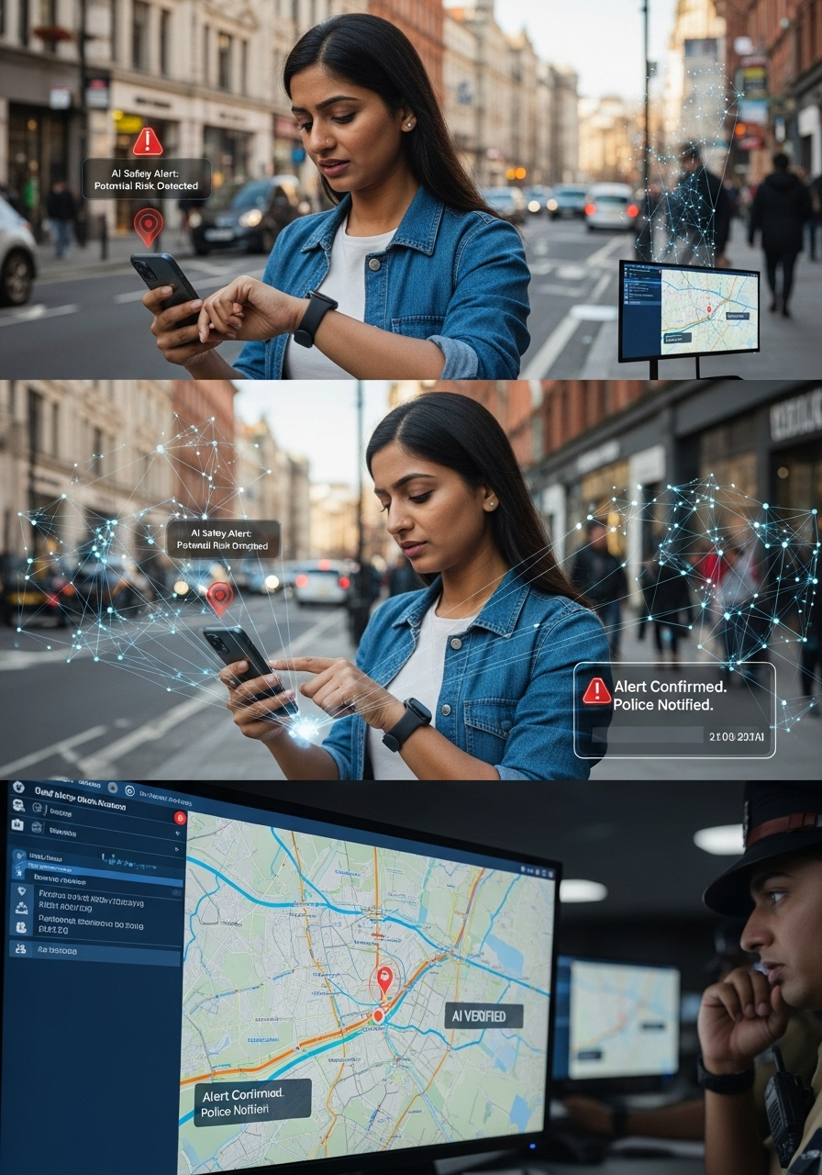
User Experience & Impact
User Journey:
1. Wearable detects distress
2. AI verifies and triggers alert
3. Blockchain records data (location, time,
proof)
4. Family / nearby users / police notified
5. User marks “Safe” to close alert
Impact:
Builds digital trust in women’s safety systems
Prevents fake or deleted alerts
Enables real-time, secure response network

Slide 5
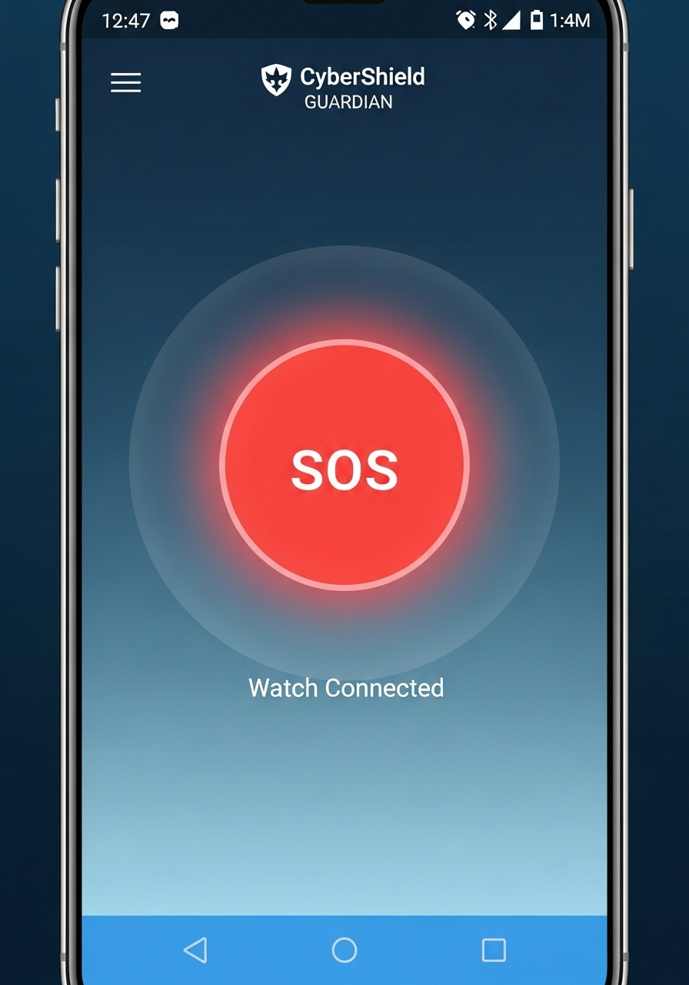
Screenshots & Wireframes
“CyberShield Guardian Prototype – App & Device Screens”
1)Home Dashboard (Main Screen)

Slide 6
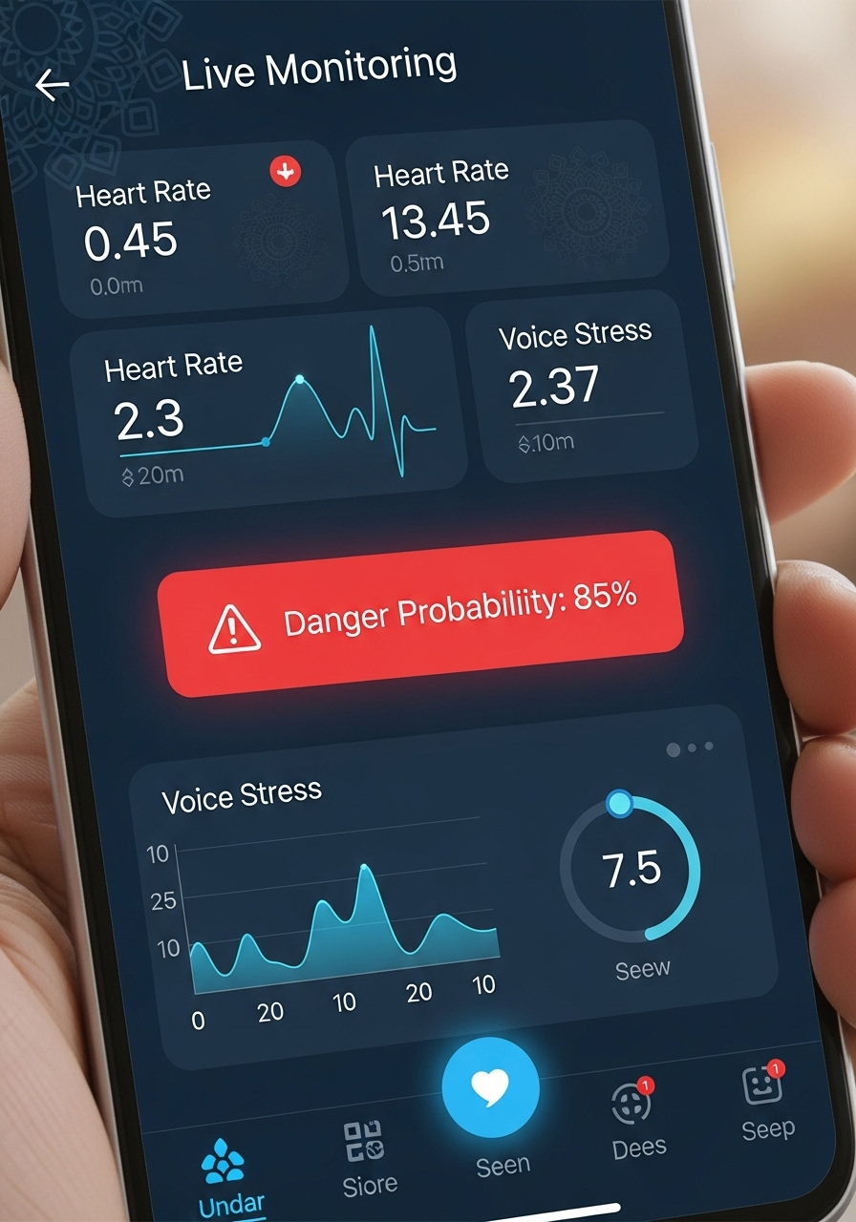
Screenshots & Wireframes
2)AI Detection:
Voice/Motion monitor

Slide 7
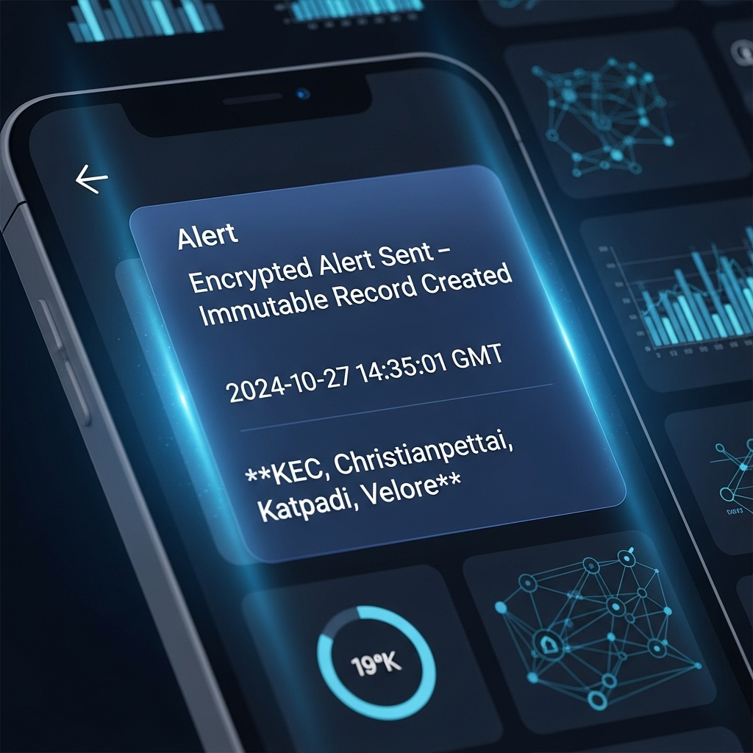
Screenshots & Wireframes
3)Blockchain Alert Log

Slide 8
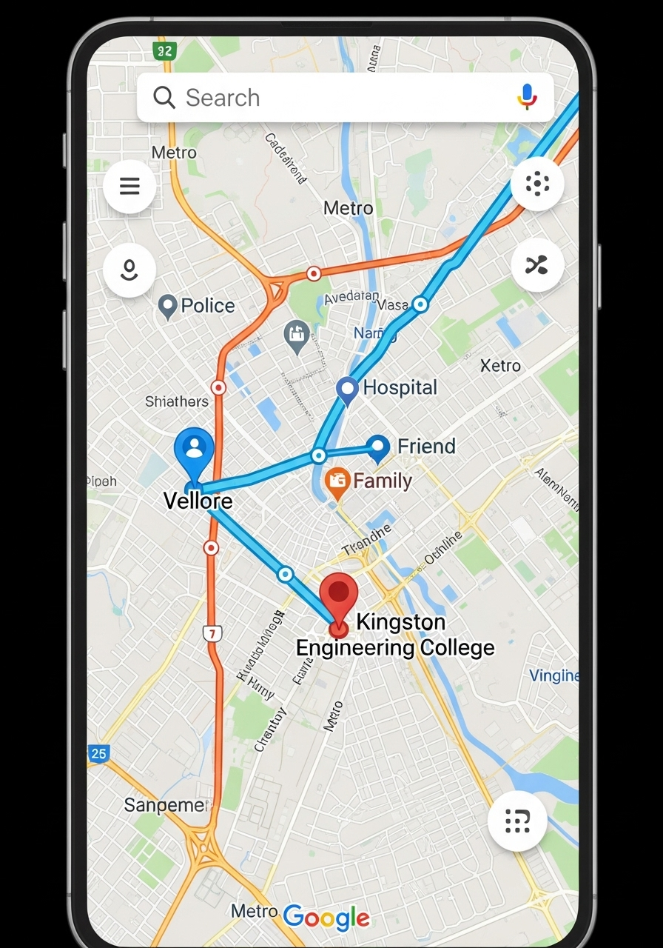
Screenshots & Wireframes
4)Verified Responders Map

Slide 9
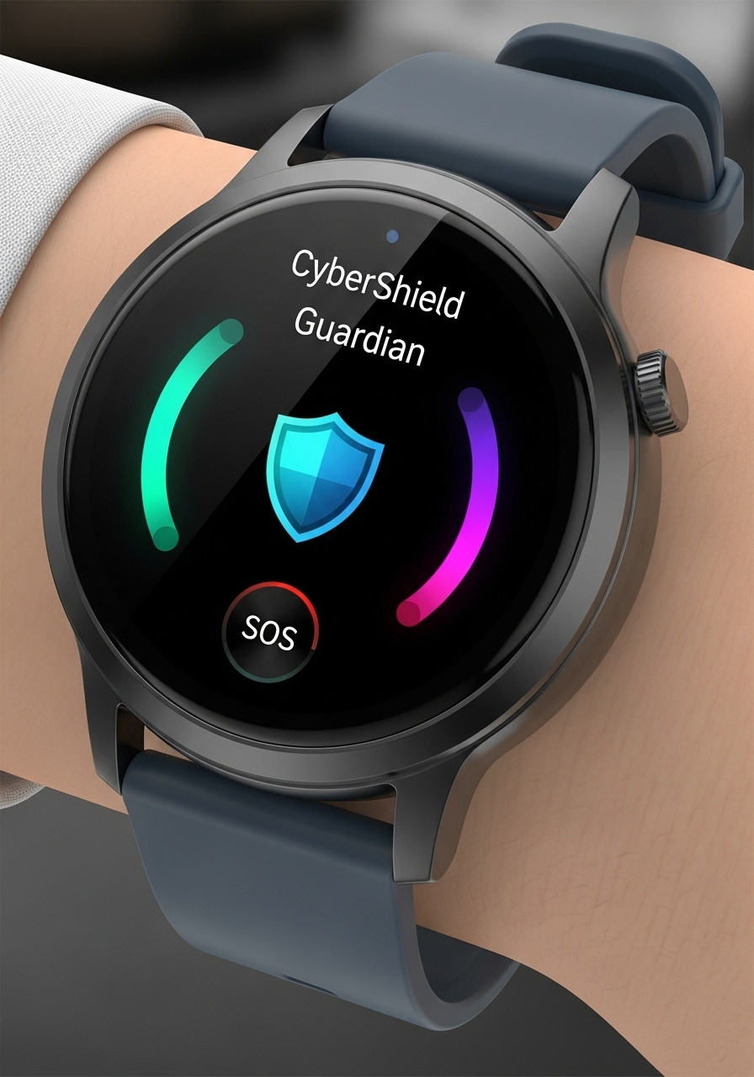
Screenshots & Wireframes
5)Smart Safety Watch Display

